Slide 1
Black-Box Testing Tools:
The black box testing can be performed with the assistance of various automated tool.
Generally, Recording and Playback tools are preferred with Java, Visual Basic and Perl, however, there are other black box testing tools that are used by blackbox testers, like:
Selenium.
Appium.
Applitools.
HP QTP.
Microsoft Coded UI.

Slide 2
Appium is an open-source Mobile Automation tool that provides automation on platforms like Android, iOS, windows.
It also supports automation using multiple programming languages like:
Java, PHP, Perl, Python, etc.
For writing automated scripts.
All applications can be automated including Native, Hybrid and Web apps.

Slide 3
Native Apps:
These apps are written using iOS, Android, or Windows SDKs.
These can be accessed only after installation in the device.
For Example, Skype, which can be used only after installation in the device. We cannot open the app through the browser.

Slide 4
Web Apps:
Mobile Web apps can be accessed using a mobile browser.
Web apps can be accessed via browser only.
For Example, Appiumtesting.com can be accessed only through the browser.
Do not have a separate App available for the website.

Slide 5
Hybrid Apps:
These apps have a wrapper around a “webview” — a native control that enables interaction with web content.
These can be installed in the device as well as accessed through browser URL.
For Example, Amazon can be installed as a separate app in the device and can also be accessed via browser as Amazon.

Slide 6
This is an HTTP server written in Node.js programming language that handles WebDriver sessions.
The Appium server receives HTTP requests from the client libraries in JSON format.
The requests are then handled in different ways, depending on the platform on which it is running on.

Slide 7
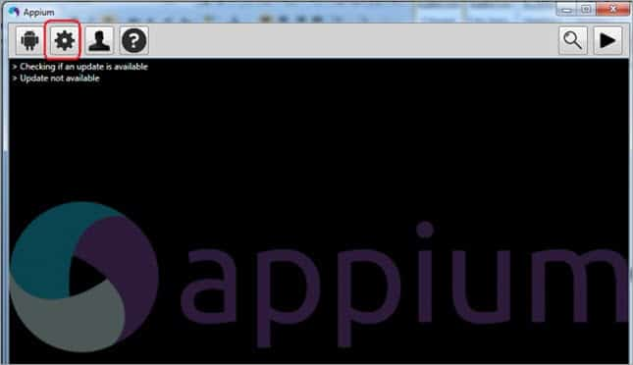
It follows the Client-Server Architecture.
There are 3 components included in it:
Appium Client
Appium Server
End device

Slide 8
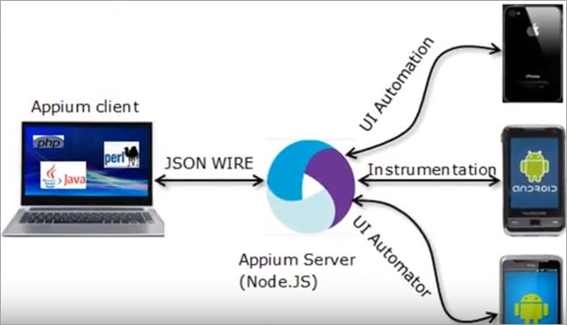

Slide 9
The Appium Client which holds the configuration details and the automation script for the test cases sends the commands to the server in JSON format.
The automation script is converted into JSON format by in-built jar files in the client.
Client contains Jar files
Automation Script in JSON
Test Cases

Slide 10
Appium Server then recognizes the command and establishes a connection with the corresponding end device. Once the connection is made, it triggers the execution of test cases in the end device. The End Device responds to the request in the form of HTTP to the Appium.
Appium Server
Test Case execution
End Device
HTTP Response

Slide 11
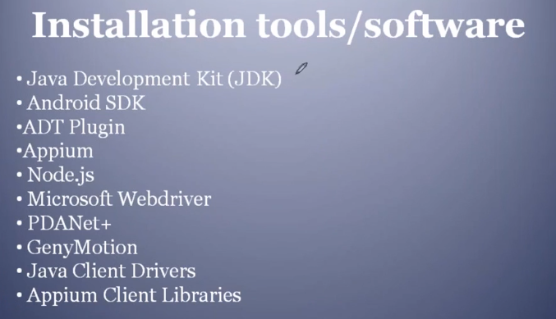

Slide 12
JSON Object Example:
A JSON object contains data in the form of key/value pair.
The keys are strings and the values are the JSON types.
Keys and values are separated by colon. Each entry (key/value pair) is separated by comma.
The { (curly brace) represents the JSON object.

Slide 13
{
“Student": {
"name": “Hemant",
“Roll No": 456,
“Regular": true
}
}
The JSON format is almost identical to JavaScript objects.

Slide 14
{“Students":[
{"name":“Manish", "email":“manish@gmail.com"},
{"name":“Jhony", "email":“anon@gmail.com"},
{"name":“vikas", "email":“Vikas@gmail.com"}
]}

Slide 15
In JSON, values must be one of the following data types:
a string
a number
an object (JSON object)
an array
a boolean
null

Slide 16
The XML representation of above JSON example is given below.
<students>
<student>
<name>Manish</name>
<email>Manish@gmail.com</email> </student>
<student>
<name>Jhony</name>
<email>Jhony@gmail.com</email>
</student>
<student>
<name>Vikas</name>
<email>Vikas@gmail.com</email> </student>
</students>

Slide 17
JSON is a schema-less, text-based representation of structured data that is based on key-value pairs and ordered lists.
JSON is derived from JavaScript, it is supported either natively or through libraries in most major programming languages.
JSON is commonly, but not exclusively, used to exchange information between web clients and web servers.
************************************

Slide 18
It’s a software metric to measure complexity of a Program.
It measures independent paths through program source code.
What is an independent path?
A path that has at least one edge which has not been
traversed before in any other path.
Cyclometic Complexity:

Slide 19
Cyclometic complexity can be calculated with respect to:
Functions
Modules
Methods
Classes within a program

Slide 20
Cyclomatic complexity determine the risk that the source code possesses for any future modification and maintenance.
Lower the Cyclomatic complexity better is the code quality in terms of complexity.

Slide 21
Importance of Cyclomatic Complexity-
It helps in determining the software quality.
It is an important indicator of program code’s readability, maintainability and portability.
It helps the developers and testers to determine independent path executions.

Slide 22
It helps to focus more on the uncovered paths.
It evaluates the risk associated with the application or program.
It provides assurance to the developers that all the paths have been tested at least once.

Slide 23
Cyclomatic complexity = E – N + 2*P
where,
E = represents a number of edges in the control flow graph.
N = represents a number of nodes in the control flow graph.
P = represents a number of nodes that have exit points in the control flow graph.

Slide 24
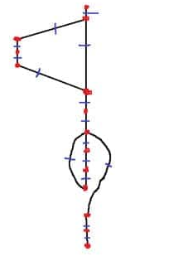
Red dotes identify the Nodes and BLUE lines to identify the edges:
So here in this example:
Number of Nodes (Red dots) = 14
Number of Edges (Blue Lines) = 15
So the Cyclomatic Complexity = E-N+2 = (15-14) +2 = 3

Slide 25
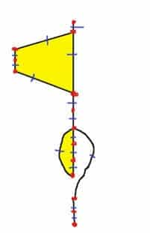
Just count the number of the closed regions and add 1 to it.
In our example above – number of closed region = 2(filled in yellow), so the CC = 2+1 = 3

Slide 26
There are 3 commonly used methods for calculating the cyclomatic complexity-
Method-01:
Cyclomatic Complexity = Total number of closed regions in the control flow graph + 1
Method-02:
Cyclomatic Complexity = E – N + 2
Here-
E = Total number of edges in the control flow graph
N = Total number of nodes in the control flow graph

Slide 27
Method-03:
Cyclomatic Complexity = P + 1
Here,
P = Total number of predicate nodes contained in the control flow graph
Note-
Predicate nodes are the conditional nodes.
They give rise to two branches in the control flow graph.

Slide 28
Calculate cyclomatic complexity for the given code-
IF A = 354
THEN IF B > C
THEN A = B
ELSE A = C
END IF
END IF
PRINT A

Slide 29
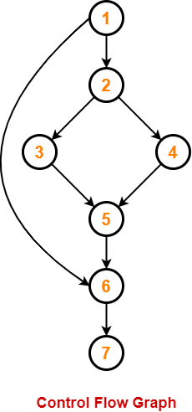
We draw the following control flow graph for the given code-

Slide 30
Method-01:
Cyclomatic Complexity
= Total number of closed regions in the control flow graph + 1
= 2 + 1
= 3
Method-02:
Cyclomatic Complexity
= E – N + 2
= 8 – 7 + 2
= 3

Slide 31
Method-03:
Cyclomatic Complexity
= P + 1
= 2 + 1
= 3

Slide 32
Cyclomatic Complexity | Meaning
1 – 10 | Structured and Well Written Code High Testability Less Cost and Effort
10 – 20 | Complex Code Medium Testability Medium Cost and Effort
20 – 40 | Very Complex Code Low Testability High Cost and Effort
> 40 | Highly Complex Code Not at all Testable Very High Cost and Effort D

Slide 33
Eg: Calculate Cyclometic complexity for swapping of values.
i = 0;
n=4;
while (i<n-1) do
j = i + 1;
while (j<n) do
if A[i]<A[j] then
swap(A[i], A[j]);
end do;
i=i+1;
end do;

Slide 34
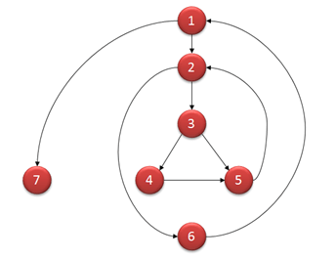

Slide 35
V(G) = 9 - 7 + 2 = 4
V(G) = 3 + 1 = 4 (Condition nodes are 1,2 and 3 nodes)
Basis Set - A set of possible execution path of a program:
1, 7
1, 2, 6, 1, 7
1, 2, 3, 4, 5, 2, 6, 1, 7
1, 2, 3, 5, 2, 6, 1, 7

Slide 36
Que: Write code for if class = TYBSC and if Div A , then lectures on Monday, Thursday and Saturday, for other days no STQA Lecture. Calculate the Cyclometic complexity for above piece of code.

Slide 37
if (class == “TYBSC”) {
if (div == “A”) {
print(‘Lecture on Monday, Thursday, Saturday');
} else {
print(‘NO STQA LECTURE');
}
}
print('END');

Slide 38
Que: Write code for if class = TYBSC and if Div B , then lectures on Tuesday, Wednesday and Friday, for other days no STQA Lecture. Calculate the Cyclometic complexity for above piece of code.

Slide 39
Que: Write piece of code for displaying message to all defaulters having Zero percentage attendance in the range of roll numbers from 801 to 900.
Calculate the cyclomatic complexity for above code.

Slide 40
for (var RollNo = 801; RollNo <= 900; RollNo++) {
if (RollNo == 2 || RollNo == 4 || RollNo == 6) {
print(‘NEED TO IMPROVE ON ATTENDANCE');
}
}
print('END');

Slide 41
Que: Write piece of code for displaying message to all defaulters having Zero percentage attendance in the range of roll numbers from 901 to 1000.
Calculate the cyclomatic complexity for above code.

Slide 42
The Benefits of Software Complexity Analysis :
Without the use of software complexity metrics, it can be difficult and time consuming to determine the architectural hotspots where risk and cost emanates.
When measuring complexity, it is important to look at coupling, cohesion, SQL complexity, use of frameworks, and algorithmic complexity.

Slide 43
Cohesion represents the degree to which a part of a code base forms a logically single atomic unit.
It is an intra-module concept.
It depicts the module’s relative functional strength.
Increase in cohesion is good for software.
High cohesion gives the best software.

Slide 44
Coupling represents the degree to which a single unit is independent from others (Coupling is the number of connections between two or more units.
It is an inter-Module concept.
It depicts the relative independence among modules.
Increase in coupling is avoided for software.
Loose coupling give the best software.

Slide 45
Space and time complexity acts as a measurement scale for algorithms.
We compare the algorithms on the basis of their space (amount of memory) and time complexity (number of operations).
The total amount of the computer's memory used by an algorithm when it is executed is the space complexity of that algorithm.

Slide 46
Software complexity measurement program provides with an opportunity to:
Improve Code Quality
Reduce Maintenance Cost
Enhance Productivity
Increase Robustness
Meet Architecture Standards

Slide 47
Black Box Testing Disadvantages :
Every object or process, impacts efficiency as well as working of the model.
So, there are few drawbacks attached to black box testing, which hinder thorough testing of the software and prohibit it from working exponentially.
____________________________________________
Working with a huge Sample space of test inputs can be exhaustive and put a drain on time.

Slide 48
It tests only a small portion of the software, as testing the software thoroughly can be time consuming.
Tests in black-box testing can be termed redundant if they are already executed by the software developer or designer.

Slide 49
Results offered by black box testing can often be overestimated.
It cannot be used for testing complex codes and softwares.

Slide 50
Besides, the probability of meeting dead ends in an unspecified path during testing is pretty high.
Because of black box testing dependency on specifications, it is difficult to design test cases without well defined, precise, as well as concise specifications. 2

Slide 51
Que 01: Explain different types of test case design techniques?
The main purpose of test case design techniques is to test the functionalities and features of the software with the help of effective test cases. The test case design techniques are broadly classified into three major categories.

Slide 52
Specification-Based techniques
Structure-Based techniques
Experience-Based techniques

Slide 53
Que 02: Explain utility & significance of Test Case?
A TEST CASE is a set of actions executed to verify a particular feature or functionality of your software application.
A Test Case contains
test steps,
test data,
precondition, postcondition
developed for specific test scenario to verify any requirement.

Slide 54
The 4 Testing Steps
1. Select what has to be measured
Analysis: Completeness of requirements
Design: tested for cohesion
Implementation: Code tests
2. Decide how the testing is done
Code inspection
Design
Black-box, white box,
Select integration testing strategy (big bang, bottom up, top down, sandwich)

Slide 55
3. Develop test cases
A test case is a set of test data or situations that will be used to exercise the unit (code, module, system) being tested or about the attribute being measured
4. Create the test oracle
An oracle contains of the predicted results for a set of test cases
The test oracle has to be written down before the actual testing takes place

Slide 56
The test case includes specific variables or conditions, using which a tester can compare expected and actual results to determine whether a software product is functioning as per the requirements of the customer.

Slide 57
Que 03: Compare and contrast White box with
Black box testing techniques?
1. Definition
2. Alternative name
3. Base of Testing
4. Usage
5. Programming knowledge
Implementation knowledge
Automation
9. Objective
10. Basis for test cases

Slide 58
11. Tested by
12. Granularity
13. Testing method
14. Time
15. Algorithm test
16. Code Access
17. Benefit
18. Skill level
19. Techniques
20. Drawbacks

Slide 59
UNIT NO : 01
Software Testing and Introduction to quality :
Introduction, Nature of errors,
an example for Testing,
Definition of Quality , QA, QC, QM and SQA , Software Development Life Cycle, Software Quality Factors

Slide 60
Verification and Validation :
Definition of V &V , Different types of V & V Mechanisms, Concepts of Software Reviews, Inspection and Walkthrough

Slide 61
Software Testing Techniques : Testing Fundamentals, Test Case Design, White Box Testing and its types, Black Box Testing and its types

Slide 62
UNIT No : 02
Software Testing Strategies :
Strategic Approach to Software Testing, Unit
Testing, Integration Testing, Validation Testing, System Testing
Software Metrics :
Concept and Developing Metrics, Different types of Metrics,
Complexity metrics
Defect Management:
Definition of Defects, Defect Management Process,
Defect Reporting, Metrics Related to Defects, Using Defects for Process
Improvement.

